Slide 1
PROBLEM SOLVING WITH LOOP AND CASE LOGIC STRUCTURE
Objective:
Develop problems using the loop logic structure
Using nested loop constructs
Distinguish the different uses of three loop constructs.

Slide 2
Pre-requisites
Short hand Assignment Operators
Assignment operators in an expression c = c + 3 can be abbreviated as c += 3(using the addition short hand assignment operator)
Examples of other short hand assignment operators:
d -= 4 (d = d -4)
e *= 5 (e = e * 5)
f /= 3 (f = f / 3)
g %= 9 (g = g % 9)

Slide 3
Pre-requisites contd…
•Increment operator (++)
–Can be used instead of c+=1
•Decrement operator ( --)
–Can be used instead of c -= 1
•Pre increment / Pre decrement
–Operator is used before the variable (++c or --c )
–Variable is changed before the expression it is in is evaluated
•Post increment / Post decrement
–Operator is used after the variable (c++ or c --)
–Expression executes before the variable is changed

Slide 4
ITERATION
Have you found yourself doing certain things over and over again?
Think of three things you do over and over again
Maybe you go shopping a few times a week
Monday Tuesday Wednesday
Wake up Wake up Wake up
Get into car Get into car Get into car
Do shopping Do shopping Do shopping
Come home Come home Come home

Slide 5
Go to statement
Transfers the system control to another instruction in the solution instead of processing the next instruction in sequence
Disadv: Reduces readability of the program.
Thus replaced by loop constructs.
Two standard tasks accomplished through the use of loop constructs:
        Counting (Incrementing and decrementing)
        Accumulating (calculating sum or total)

Slide 6
Types of loops
While/ WhileEnd statement
Repeat/Until
Automatic-Counter loop

Slide 7
While Statement
The while statement is used when the program needs to perform repetitive tasks.
While the condition is true, repeat all instructions between While and the WhileEnd.
The while statement has the form:
while <condition(s)>
Instruction
Instruction
Instruction
.
.
WhileEnd

Slide 8
While/While End
Algorithm:
While<condition(s)>
Instruction
Instruction
.
.
WhileEnd
A
While
<Condition(s)>
F
T
Instruction
Instruction
B

Slide 9
Decision equivalent to While/whlile end
Algorithm:
100: If<conditions)>
Then
Instruction
Instruction
GoTo100
A
if
<Condition(s)>
T
F
T
Instruction
Instruction
GoTo
B

Slide 10
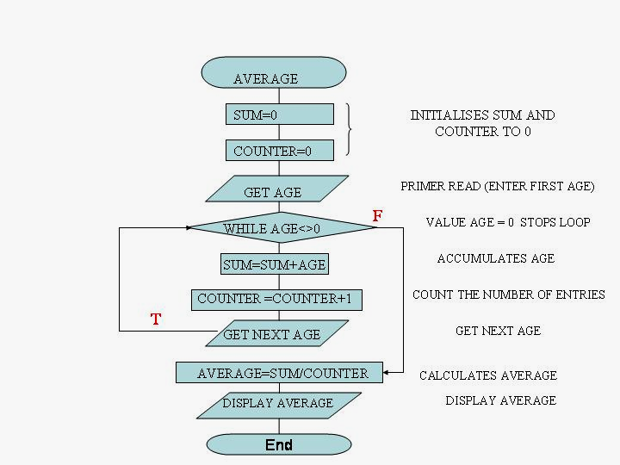
To calculate average of input ages
ALGORITHM
Set sum to zero
Set counter to zero
Get age (priming Read)
WHILE age <> 0
  Sum = sum + age
  Counter = counter + 1
  Get next age
WHILE END
Average =sum/counter
Display average
End

Slide 11
Repeat/Until
It tells the computer to
repeat the set of instructions
between the Repeat and until ,
until a condition is true
Algorithm:
Repeat
Instruction
Instruction
.
.
Until<condition(s)>
A
Repeat
Instruction
Instruction
F
Until<condition(s)>
T
B

Slide 12
Decision equivalent to Repeat-until loop
10 Instruction
11 Instruction
12 If<condition(s)>
Then
Continue
Else
Go To 10
A
Instruction
T
Instruction
T
F
if
<Condition(s)>
Go To
F
B

Slide 13
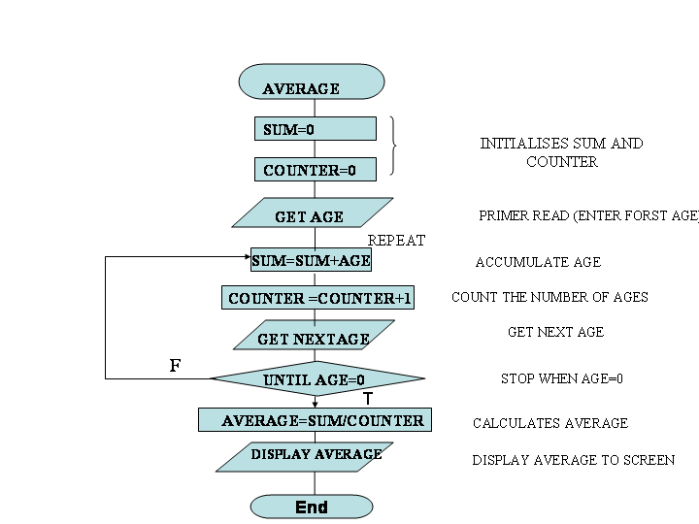
To calculate average of input ages
ALGORITHM
Set sum to zero
Set counter to zero
Get age (priming lead)
REPEAT
  Sum = sum + age
  Counter = counter + 1
  Get next age
UNTIL AGE = 0
Average =sum/counter
Display average
End

Slide 14
Difference between While/WhileEnd and Repeat/Until loop structures
While/WhileEnd
Program continues to loop as long as the condition is true.
Condition is evaluated at the beginning.
If the condition fails at the beginning itself, then instructions are not executed even once.
Repeat/Until
Program stops the loop process if the condition is true.
Condition is evaluated at the end.
Ensures execution of the instruction inside loop at least once in the program.

Slide 15
AUTOMATIC COUNTER LOOP
It increments or decrements a variable each time the loop is repeated.
A variable acts as a counter that is initialized and incremented/decremented each time the loop is processed.
The loop terminates when the counter exceeds the upperlimit.
The test for whether or not to continue is present at the beginning or end of the loop depending on the language.

Slide 16
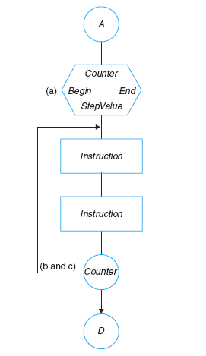
AUTOMATIC COUNTER LOOP
FLOWCHART
ALGORITHM
Loop: Counter =Begin To End Step S
Instruction
Instruction
.
.
Loop-End :Counter
Loops increments or decrements a variable each time the loop is repeated.

Slide 17
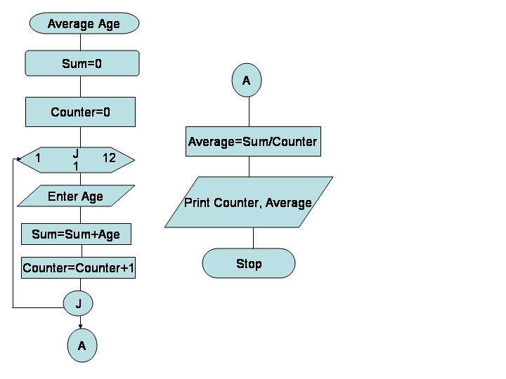
Algorithm and Flowchart Using Automatic Counter Loop
1.AverageAge
2.Sum=0
Counter=0
3.Loop:J=1 to 12
Enter Age
Sum= Sum +Age
Counter=Countet+1
Loop-End: J
4.Average=Sum/Counter
5.Print Counter, Average
6.End

Slide 18
Indicators
Indicators are logical variables that a programmer sets within a program to change the processing path or to control when the processing of a loop should end.
They are sometimes called flags, switches or trip values
Error indicator –designates that an error has occurred in the input or output.
End-of-data indicator-designates that there are no more data to be entered.
Ex:Zero value of age

Slide 19
RECURSION
When a module or a function calls itself.
The condition that ends the loop must be within the module
Usually faster.
Ex. Recursive function Factorial(N) continues to call itself until N=1
Control Fact(N)
Enter N 1. If(N>1) then
Nfact=Fact(N) Return Factorial=N*fact(N-1)
Print Nfact Else
End Return Factorial=1
2. Exit

Slide 20
CASE Structure Flowchart
Made up of several sets of instructions, of which only one will be selected and executed by the user input.
CaseOfVariable
=CONSTANT1:
actions for variable = CONSTANT1
=CONSTANT2:
actions for variable = CONSTANT2
=CONSTANT3:
actions for variable = CONSTANT3
.
.
Otherwise:
actions for variable = Anything else
EndOfCase
Notes:
This linear nested IF structure can be replaced with a case control structure.

Slide 21
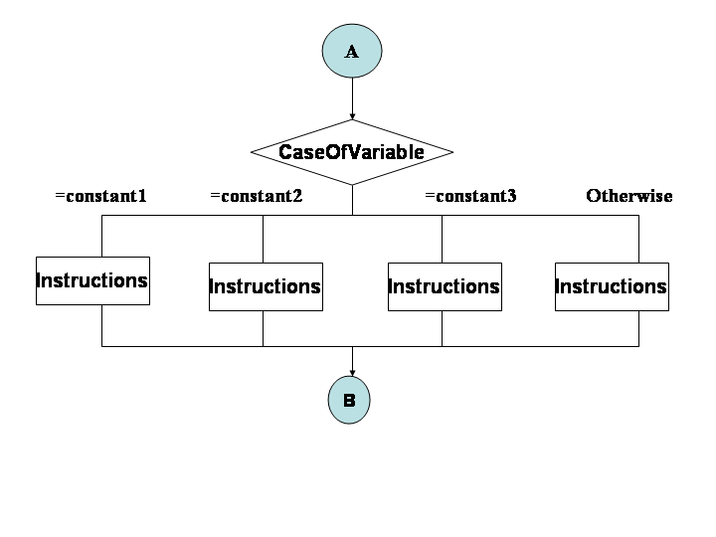
CASE Structure
Notes:
This linear nested IF structure can be replaced with a case control structure.

Slide 22
Codes & Indicators
Codes are characters, character strings, numbers, or some combination of these types of data that a programmer uses to name the options, the constants, in a case structure
Major Difference between Indicators and Codes
1.Codes are data to be entered by the user whereas Indicators are internal signals to change the processing path.
2.A code can have a value of many different types whereas the value of an indicator can be logical data-True or False value

